Slide 1
BHOJ REDDY ENGINEERING COLLEGE FOR WOMEN
DEPARTMENT OF INFORMATION TECHNOLOGY
IV B Tech. II Sem. A Sec. Seminar Presentation
Academic year 2021-22 Date:21/06/2022
BAT: DEEP LEARNING METHOD FOR IDS IN WIRELESS NETWORKS
Presented by
J AKANKSHA(18321A1204)
G GAYATHRI(18321A1221)
MANOGNA T(18321A1248)
Maya B Dhone M Sandhya Rani C Murugamani
Internal Guide Co-ordinator HOD-IT
Assistant Professional
Associate Professional
Associate Professional

Slide 2
CONTENTS​
Introduction
Project Scope
Existing System
Proposed System
Functional Requirements
Non Functional Requirements
Computational Resources
Life Cycle Model
System and Technical Architecture
Modules
Implementation​
Screenshots​
Conclusion​
Future Scope​
References​

Slide 3
INTRODUCTION
Intrusion detection can identify unknown attacks from network traffics and has been an effective means of network security. Nowadays, existing methods for network anomaly detection are usually based on traditional machine learning models, such as KNN, SVM, etc. To solve the problems of low accuracy and feature engineering in intrusion detection, a traffic anomaly detection model BAT is proposed. The BAT model combines BLSTM (Bidirectional Long Short-term memory) and attention mechanism.

Slide 4
PROJECT SCOPE
We compare the performance of BAT-MC with traditional deep learning methods, the BAT-MC model can extract information from each packet. By making full use of the structure information of network traffic, the BAT-MC model can capture features more comprehensively.
We evaluate our proposed network with a real NSL-KDD dataset. The experimental results show that the performance of BAT-MC is better than the traditional methods.

Slide 5
EXISTING SYSTEM
In the existing system, many machine learning algorithms such as KNN, and RNN are used which are less accurate compared to the SLTM algorithm.
The IDS monitors the operations of a host or a network, alerting the system administrator when it detects a security violation.
We review the technologies involved in the Intrusion Detection System to handle security issues in IoT environments.

Slide 6
PROPOSED SYSTEM
We propose an end-to-end deep learning model BAT-MC that is composed of BLSTM and attention mechanisms. BAT-MC can well solve the problem of intrusion detection and provide a new research method for intrusion detection.
The attention mechanism conducts feature learning on sequential data composed of data package vectors. The obtained feature information is reasonable and accurate.

Slide 7
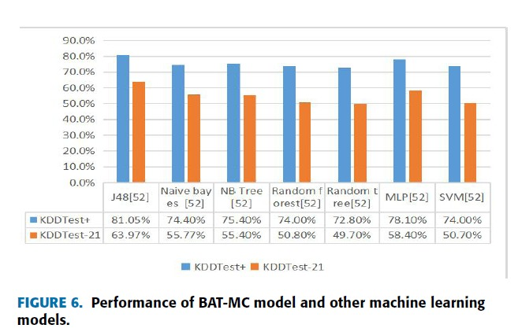
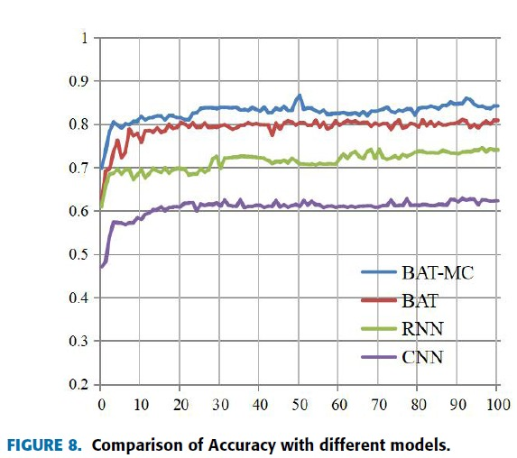

Slide 8
FUNCTIONAL REQUIREMENTS
Firstly, we obtain the NSL-KDD dataset from an open-source.
Then we perform data preprocessing by cleaning the unnecessary attributes and filtering out the missing data.
We now build a BATMC Model by making use of the BLSTM algorithm.
Evaluation of the BATMC model is done using the evaluation metrics like Accuracy(A), True positive Rate(TPR), and False Positive Rate(FPR) with the help of training and testing datasets.
By using the Localhost(IP Address:127.0.0.1) we pass the url’s to that localhost to check whether that site is malicious or not.

Slide 9
NON-FUNCTIONAL REQUIREMENTS
Non-Functional requirements include quantitative constraints, such as response time (i.e., how fast the system reacts to user commands) or accuracy (i.e., how precise are the systems numerical answers)
Usability
Recoverability
Security
Availability
Interoperability
Reliability
Maintainability

Slide 10
COMPUTATIONAL RESOURCES
HARDWARE:
PROCESSOR : Intel I3​
RAM : 4 GB​
HARD DISK : 250 GB​
SOFTWARE:
PLATFORM : Python
OPERATING SYSTEM : Windows10
IDE : Python IDE 3.7v

Slide 11
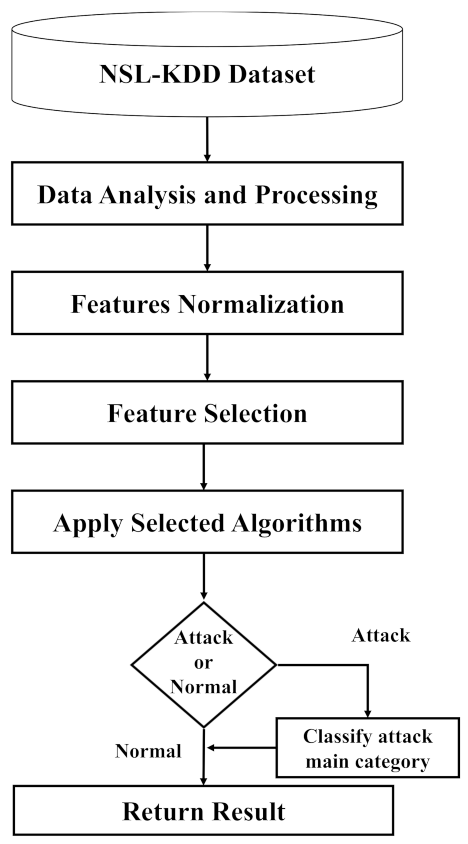

SYSTEM ARCHITECTURE

Slide 12
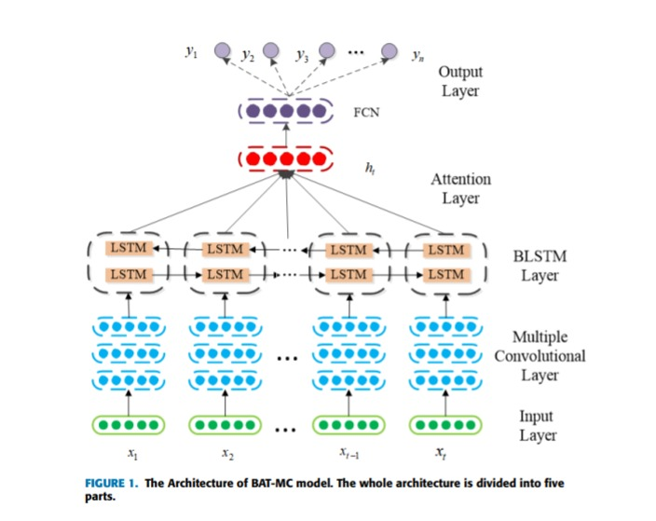
TECHNICAL ARCHITECTURE

Slide 13
MODULES
The system after a careful analysis has been identified to be presented with the following modules:
DATA COLLECTION: The main data sets were collected from the Kaggle deep learning repository which is an open data resource for data mining and for predictive analytics purposes. The acquired data source was a CSV file.
DATA CLEANING: The data in the CSV files need to be checked to whether it has any missing values, as the data source has missing values every attribute has been checked using the filters, and null values are removed which helps to increase the accuracy level.

Slide 14
BENCHMARK DATASETS: The final result of network traffic anomaly detection is closely related to the dataset. The NSL-KDD dataset is mainly composed of the KDDTrain+ training dataset, KDDTest+, and KDDTest-21 testing dataset, which can make a reasonable comparison with different methods of the experimental results, the NSL-KDD dataset has different normal records and four different types of abnormal records. The KDDTest-21 dataset is a subset of the KDDTest+.
MODELLING: We propose an end-to-end deep learning model BAT-MC that is composed of BLSTM and attention mechanisms. BAT-MC can well solve the problem of intrusion detection and provide a new research method for intrusion detection.

Slide 15
EVALUATION METRIC: In this, Accuracy (A) is used to evaluate the BATMC model. Except for accuracy, true positive rate (TPR) and false-positive rate (FPR) are also introduced. These three indicators are commonly used in the research field of network traffic anomaly detection, here True Positive (TP) represents the correct classification of the Intruder. False Positive (FP) represents the incorrect classification of a normal user taken as an intruder. True Negative (NP) represents a normal. user classified correctly. False Negative (FN) represents an instance where the intruder is incorrectly classified as a normal user.
VISUALIZATION: By giving train and test data to the BAT-MC model it identifies the malicious URL’s from normal URL’s. It displays the output in the text format in a short window within a localhost browser.

Slide 16
ALGORITHMS
Recurrent Neural Network:
A recurrent Neural Network is a generalization of a feedforward neural network that has internal memory. RNN is recurrent in nature as it performs the same function for every input of data while the output of the current input depends on the past computation. After producing the output, it is copied and sent back into the recurrent network. For making a decision, it considers the current input and the output that it has learned from the previous input.

Slide 17
Disadvantages of Recurrent Neural Network
Gradient vanishing and exploding problems.
Training an RNN is a very difficult task.
It cannot process very long sequences if using tanh or relu as an activation function.

Slide 18
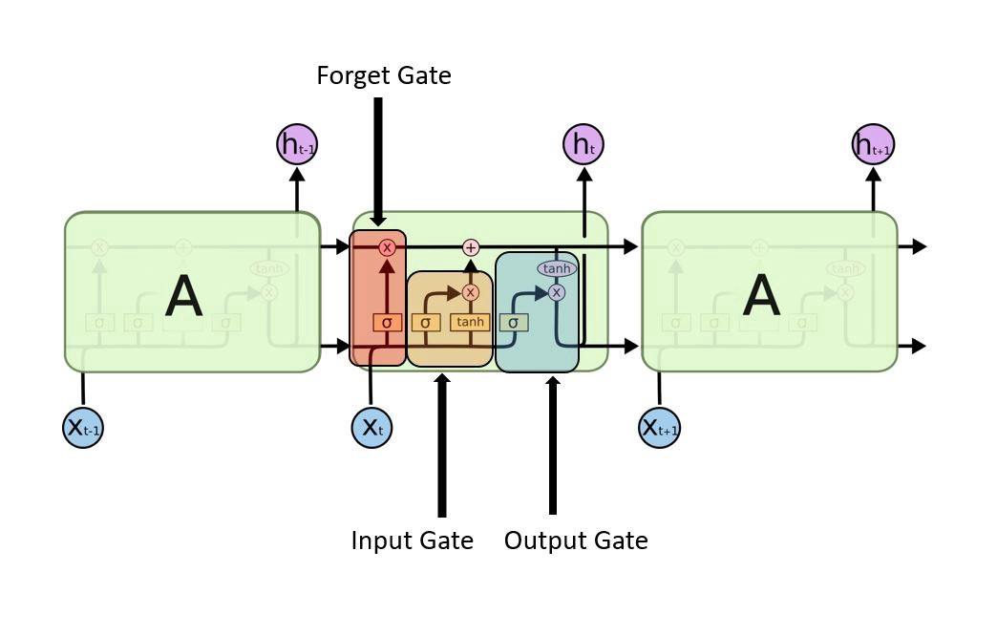
Long Short-Term Memory (LSTM):
Long Short-Term Memory (LSTM) networks are a modified version of recurrent neural networks, which makes it easier to remember past data in memory. The vanishing gradient problem of RNN is resolved here. LSTM is well-suited to classify, process and predict time series given time lags of unknown duration. It trains the model by using back-propagation. In an LSTM network, three gates are present:
LSTM gates

Slide 19
IMPLEMENTATION
Views:
import warnings
warnings.warn = warn
import warnings
import joblib
from lxml import html
from json import dump, loads
from requests import get
import json
from re import sub
from dateutil import parser as dateparser
from time import sleep
from django.http import HttpResponse
from django.shortcuts import render

Slide 20
import os
import pickle
import joblib
import whois
import datetime
def result(request):
#nm=request.GET['url'] text=request.GET['url']
if not text.startswith('http'):
return render(request,"404.html")
if text.startswith('https://malicious-url-detectorv5.herokuapp.com/') :
return render(request,'result.html',{'result':'Real-time analysis successfull','f2':'Legtimate','mal': True,'text':text,'name':"The Legions",
'org':"The Legions",
'add':"New Delhi",

Slide 21
'city':"New Delhi",
'state':"New Delhi",
'ziip':"201301",
'country':"India",'emails':"thelegions@gmail.com",
'dom':"Hidden For Privacy",'rank':"Hidden For Privacy","tags":"Hidden For Privacy","registrar":"Hidden For Privacy","var13":"NA","varab":"NA","var11":"NA","var10":"NA","var5":"NA","var4":"NA","var3":"NA"})
elif text.startswith('https://www.google.com/search?q='):
return render(request,'result.html',{'result':'Real-time analysis successfull','f2':'Legtimate','mal': True,'text':text,'name':"NA for google search",
'org':"NA for google search",
'add':"NA for google search",
'city':"NA for google search",

Slide 22
'state':"NA for google search",
'ziip':"NA for google search",
'country':"NA for google search",'emails':"NA for google search",
'dom':"NA for google search",'rank':"NA for google search","tags":"NA for google search","registrar":"Hidden For Privacy","var13":"NA for google search","varab":"NA for google search","var11":"NA for google search","var10":"NA for google search","var5":"NA for google search","var4":"NA for google search","var3":"NA for google search"})

Slide 23
Model Classification:
from django.db import models
# Create your models here.
class Url(models.Model):
urlid = models.AutoField(primary_key=True)
link = models.CharField(max_length=1000,null=True,default="Not Found")
result = models.CharField(max_length=100,null=True,default="Not Found")
add = models.CharField(max_length=1000,null=True,default="Not Found")
org = models.CharField(max_length=100,null=True,default="Not Found")
city = models.CharField(max_length=100,null=True,default="Not Found")
state = models.CharField(max_length=100,null=True,default="Not Found")

Slide 24
country = models.CharField(max_length=100,null=True,default="Not Found")
dom = models.CharField(max_length=100,null=True,default="Not Found")
emails = models.CharField(max_length=100,null=True,default="Not Found")
rank = models.IntegerField(null=True,default=0,blank=True)
registrar = models.CharField(max_length=100,null=True,default="Not Found")
#rank = models.CharField(max_length=100,null=True,default="N A",blank=True)
created_at = models.DateTimeField(auto_now_add=True)

Slide 25
URL Patterns:
from django.urls import path
from . import views
urlpatterns = [
path('',views.index,name='index'),
path('getuserfeedbackform',views.getuserfeedbackform,name="getuserfeedbackform"),
path('saveuserfeedbackform',views.saveuserfeedbackform,name="saveuserfeedbackform"),
path('api',views.api,name='api'),
path('search',views.search,name="search"),
path('result',views.result,name='result'),
path('about',views.about,name='about'),

Slide 26
path('geturlhistory',views.geturlhistory,name="geturlhistory"),
path('discuss',views.discuss,name="discuss"),
path('reply/<int:replyid>',views.replyform,name="reply"),
path('savereply',views.savereply,name="reply"),
path('searchdiscuss',views.searchdiscuss,name="searchdiscuss"),
path('getdataset',views.getdataset,name='getdataset'),
path('getdocs',views.getdoc,name='namedoc')
]

Slide 27
App:
from django.apps import AppConfig
class MyappConfig(AppConfig):
name = 'myapp’
Admin:
from django.contrib import admin
from .models import *
# Register your models here.
admin.site.register(Url)

Slide 28
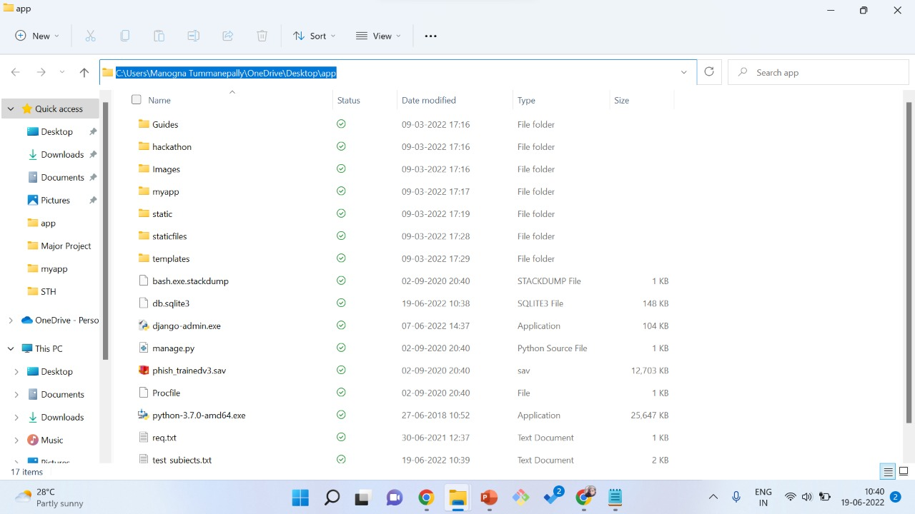
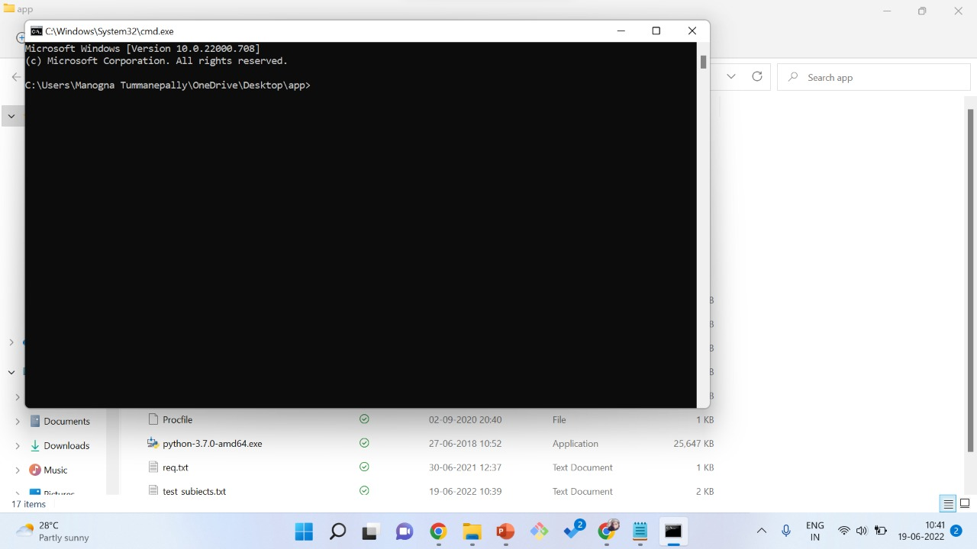
SCREENSHOTS
Screenshot 1
Screenshot 2

Slide 29
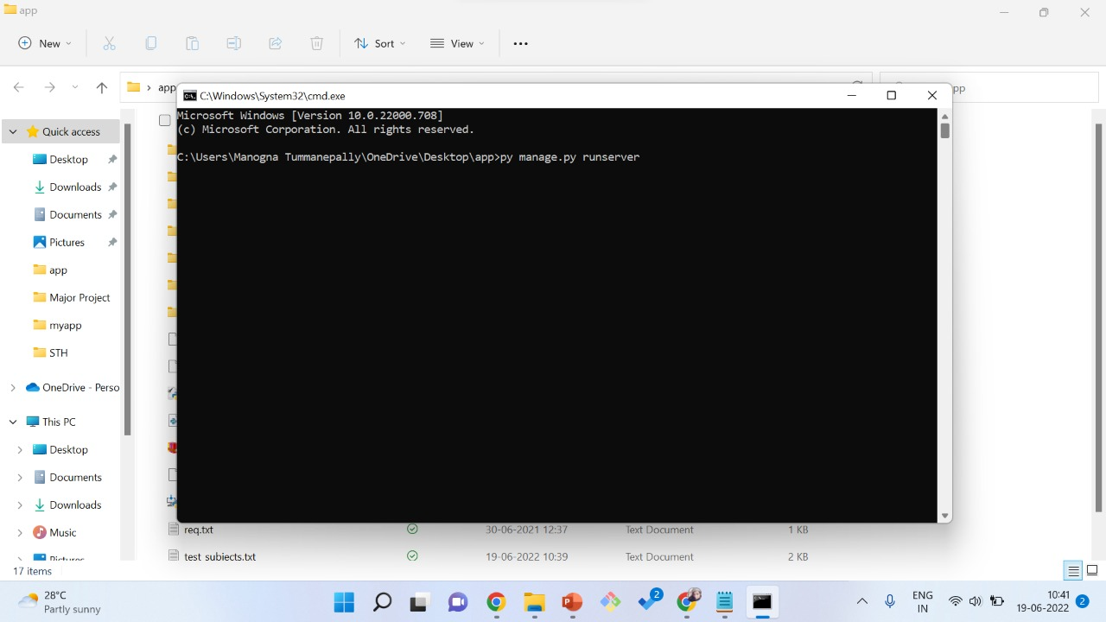
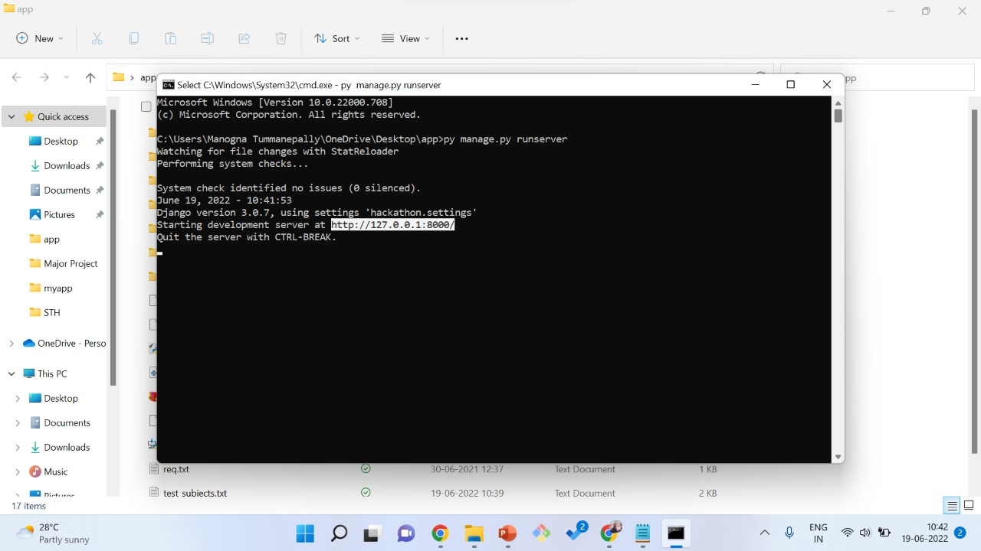
Screenshot 3
Screenshot 4

Slide 30
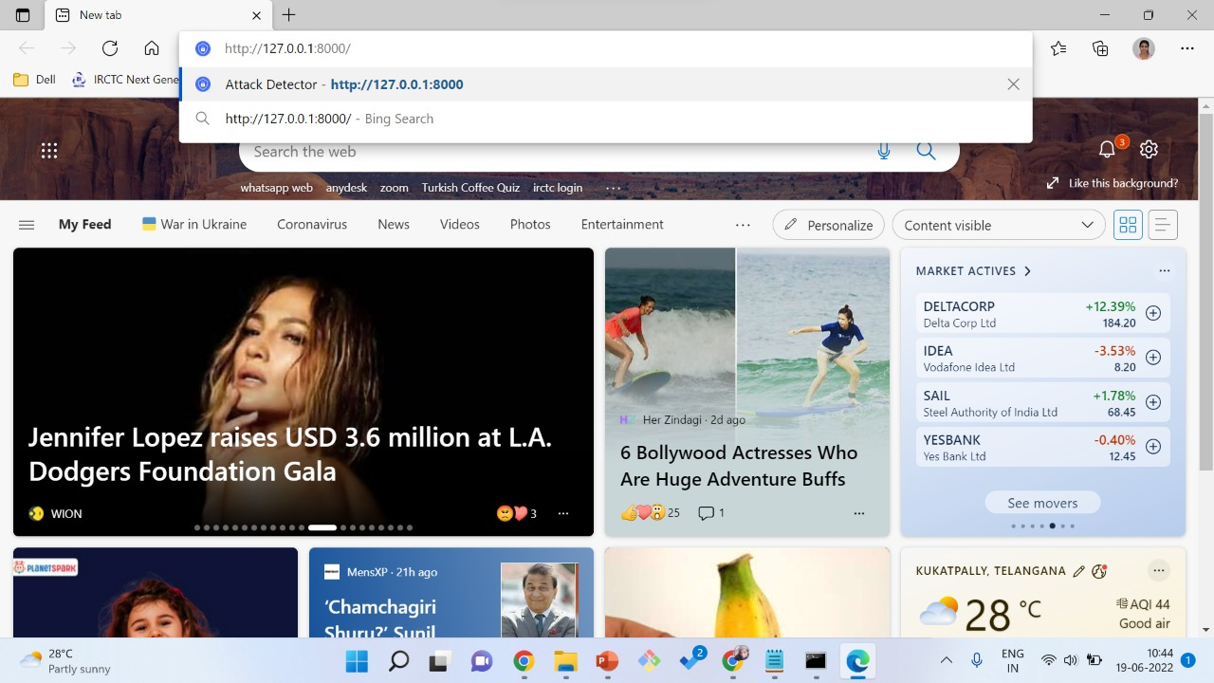
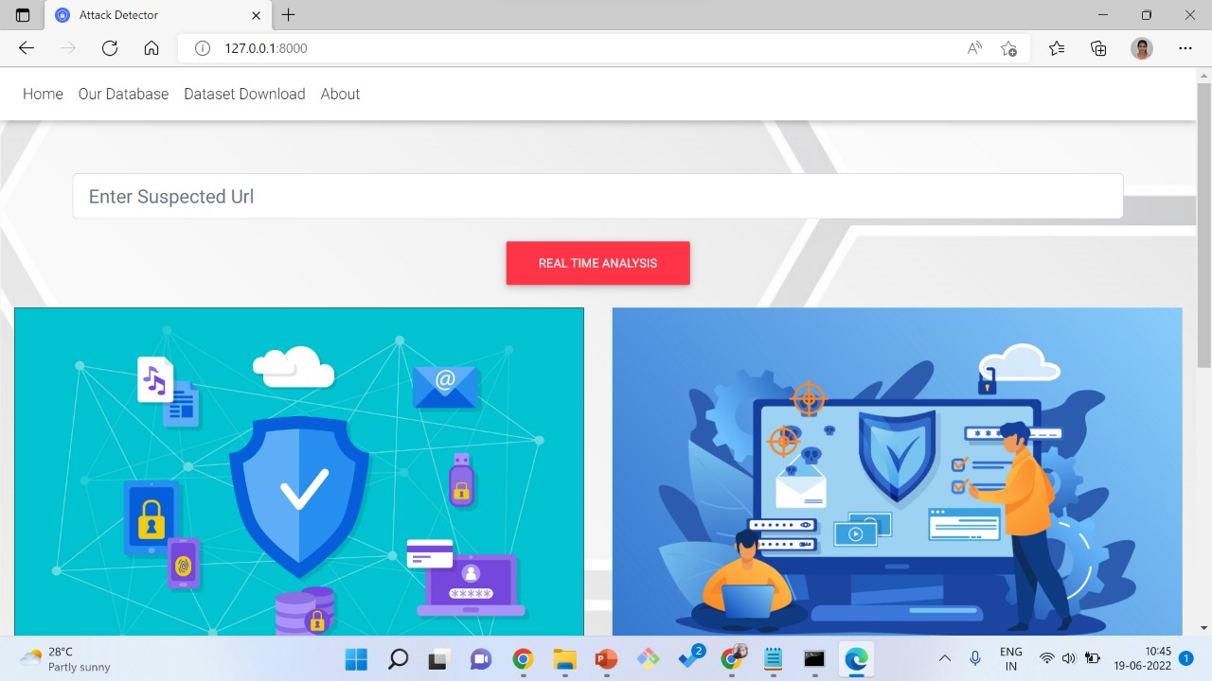
Screenshot 5
Screenshot 6

Slide 31
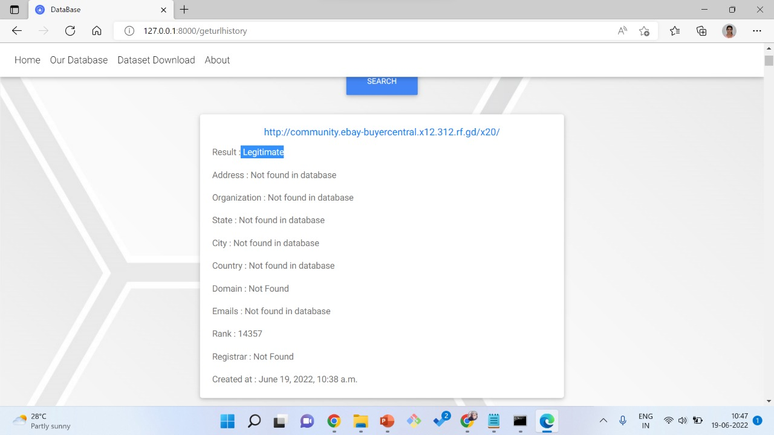
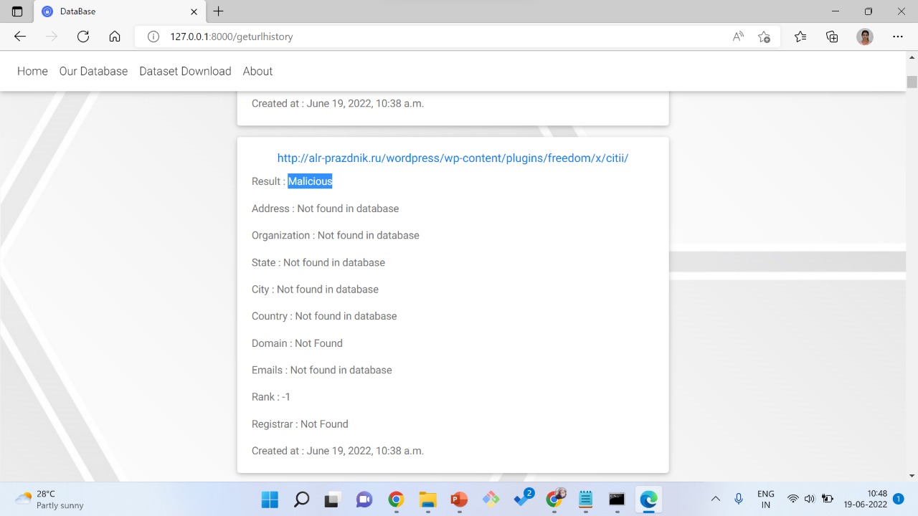
Screenshot 7:
Screenshot 8:

Slide 32
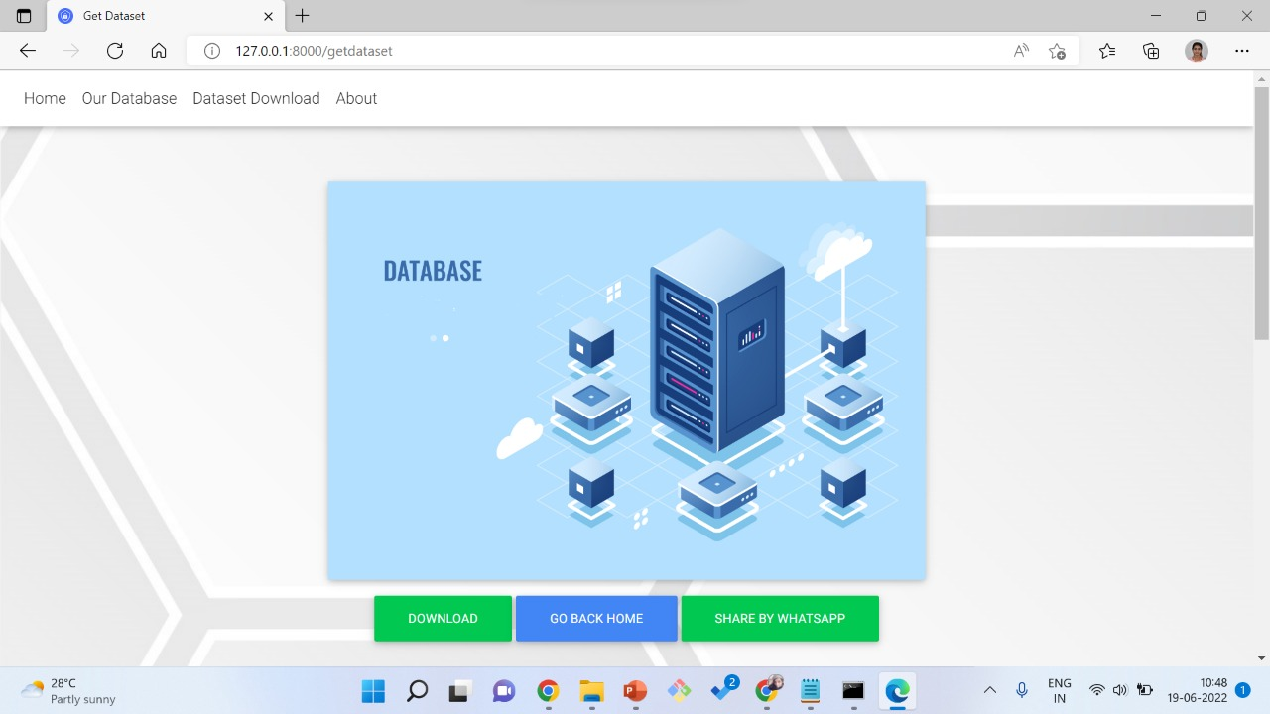

Screenshot 9:
Screenshot 10:

Slide 33
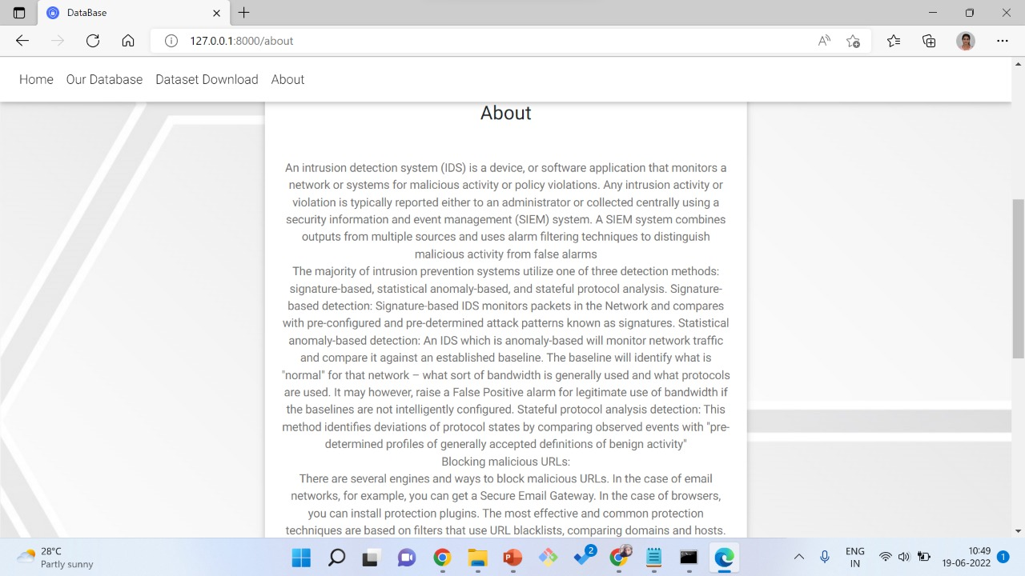
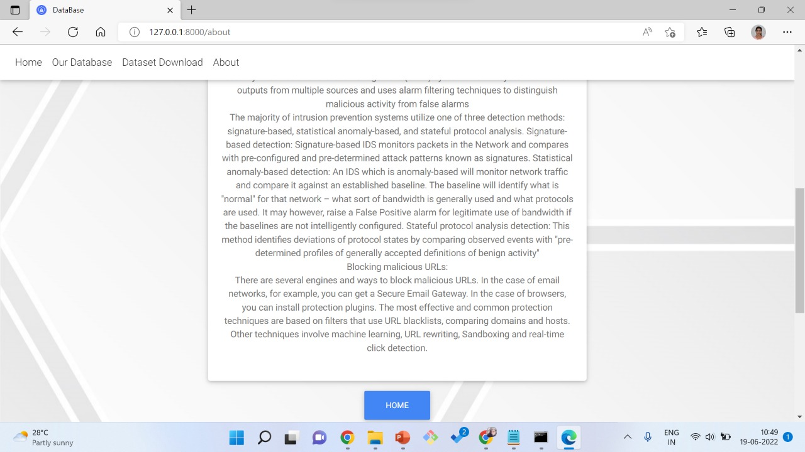
Screenshot 11:
Screenshot 12:

Slide 34
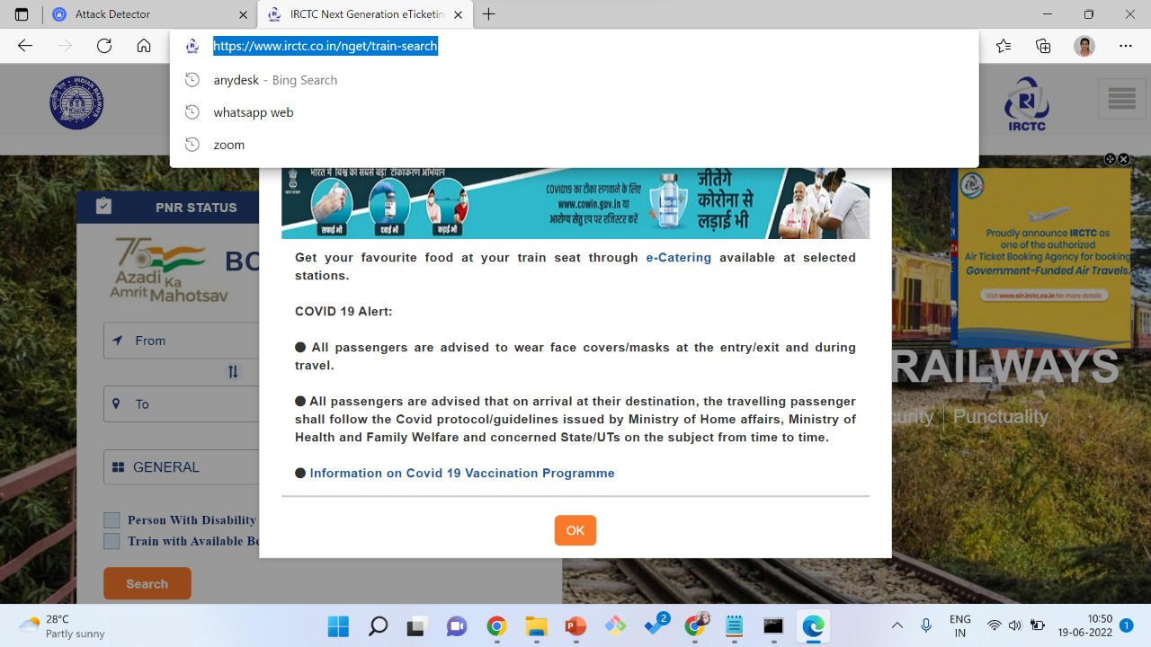
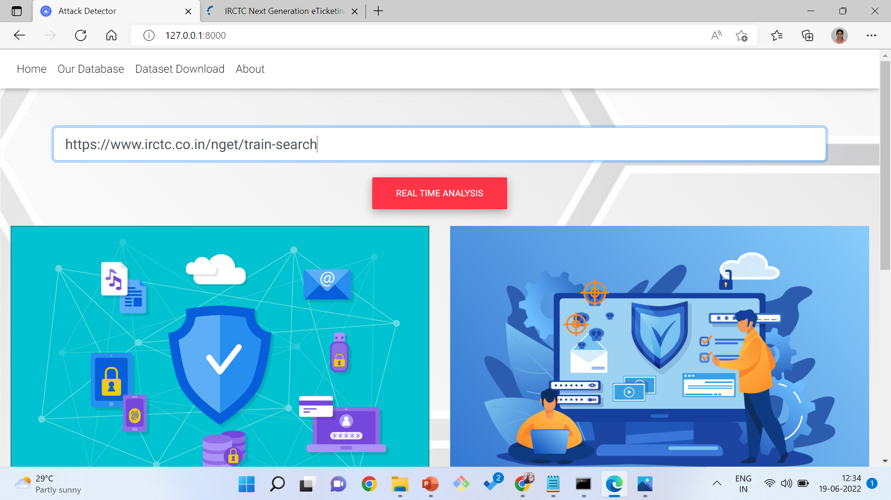
Screenshot 13:
Screenshot 14:

Slide 35
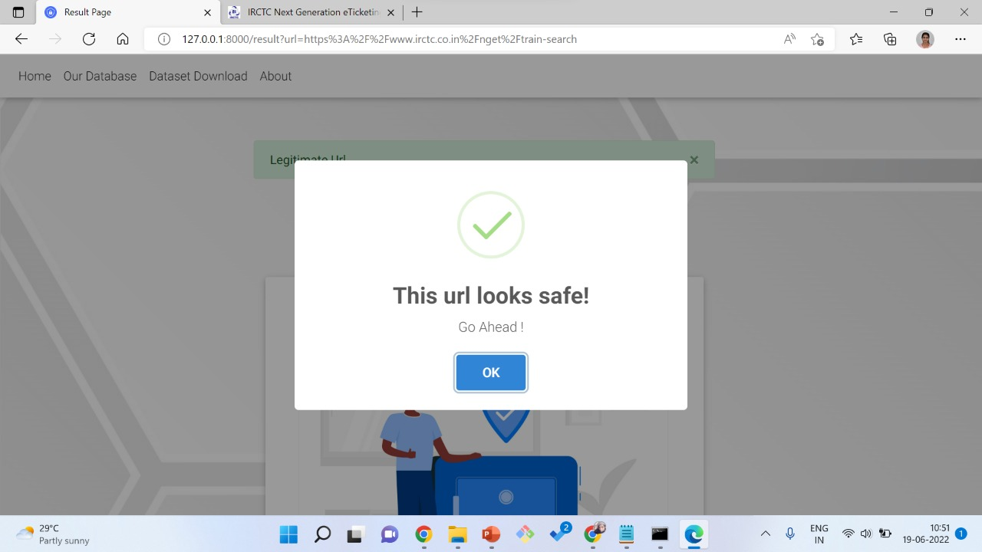
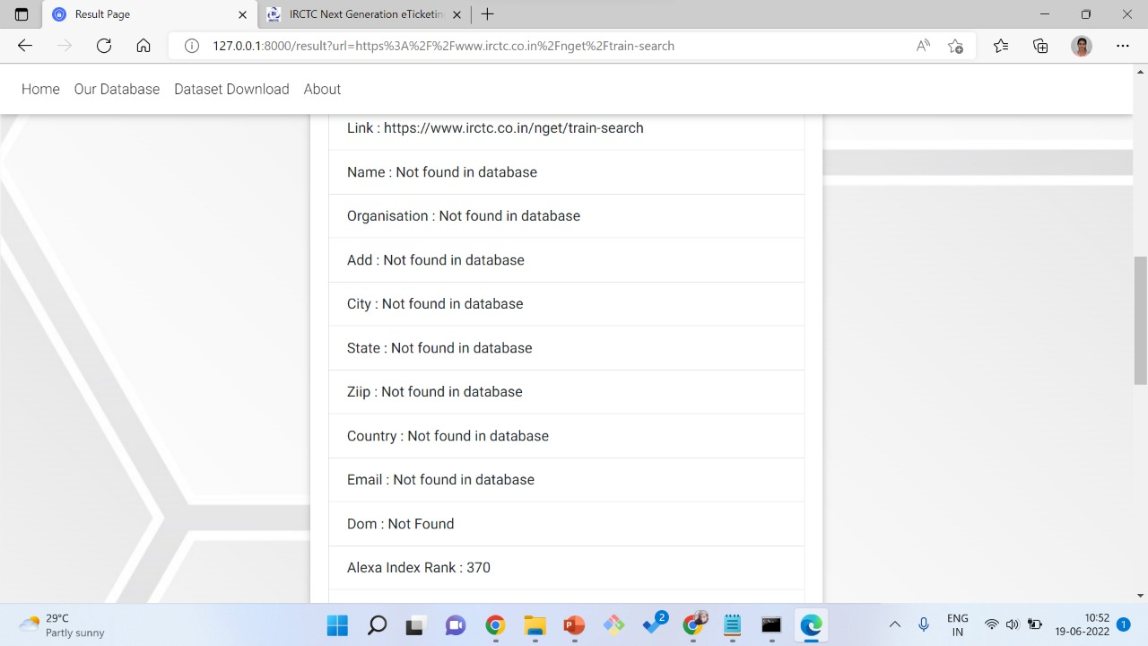
Screenshot 15:
Screenshot 16:

Slide 36

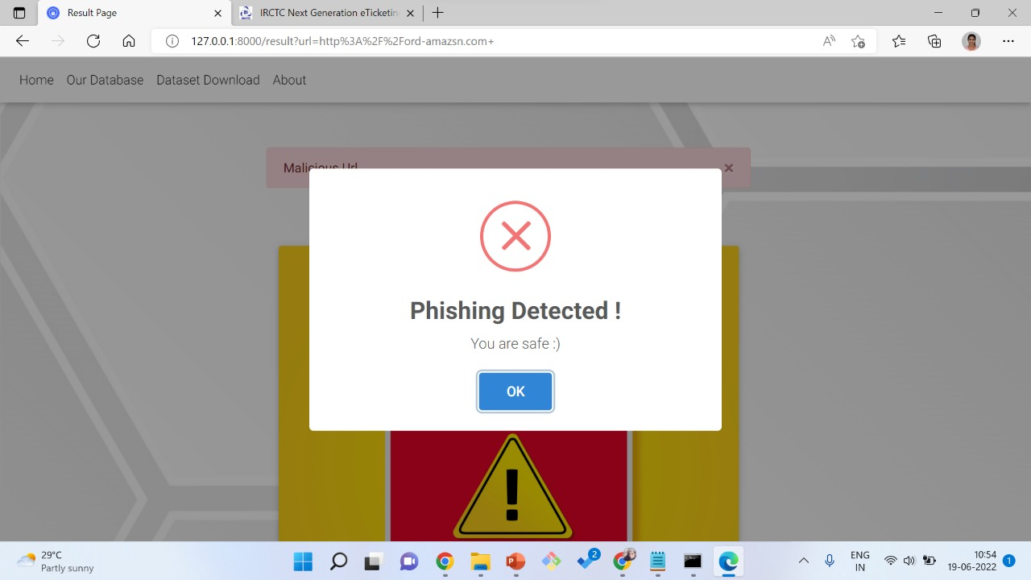
Screenshot 17:
Screenshot 18:

Slide 37
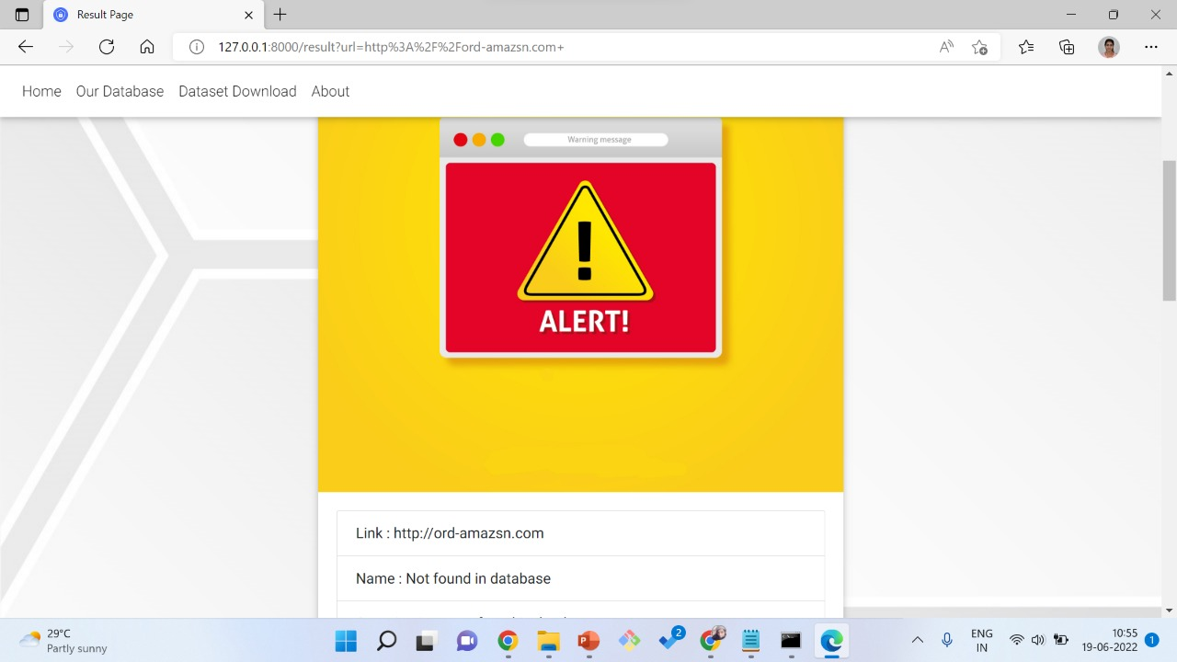
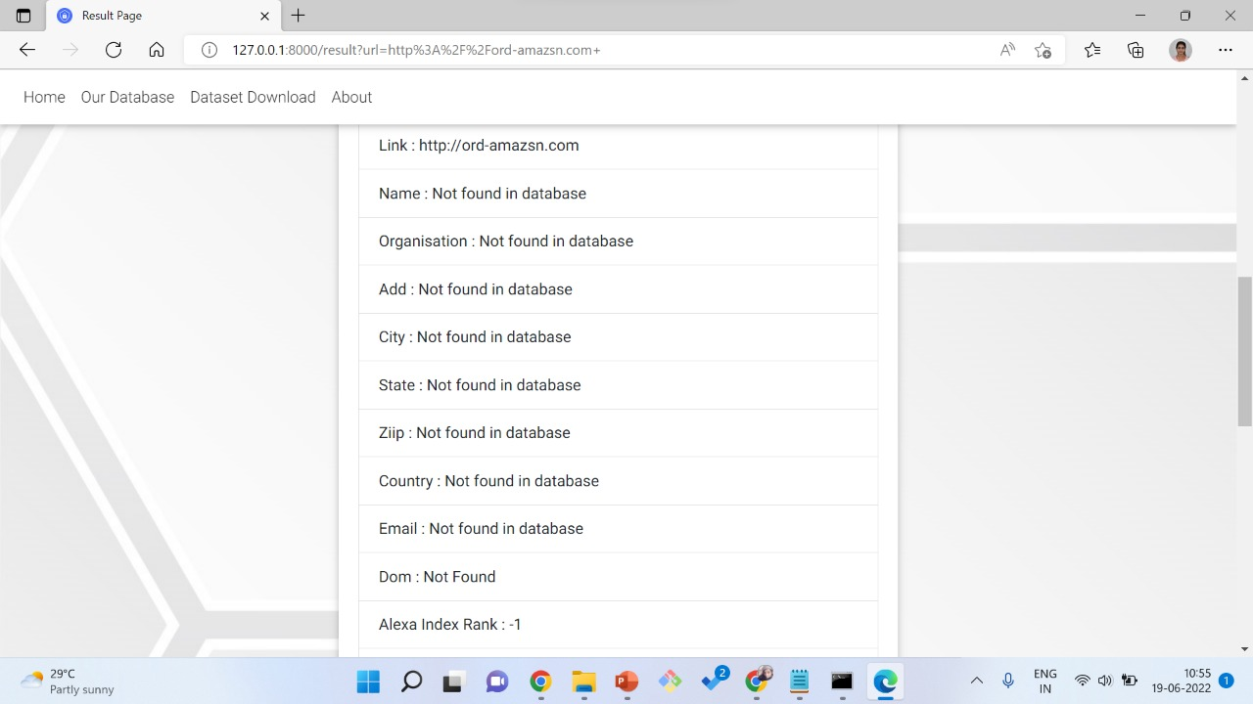
Screenshot 19:
Screenshot 20:

Slide 38
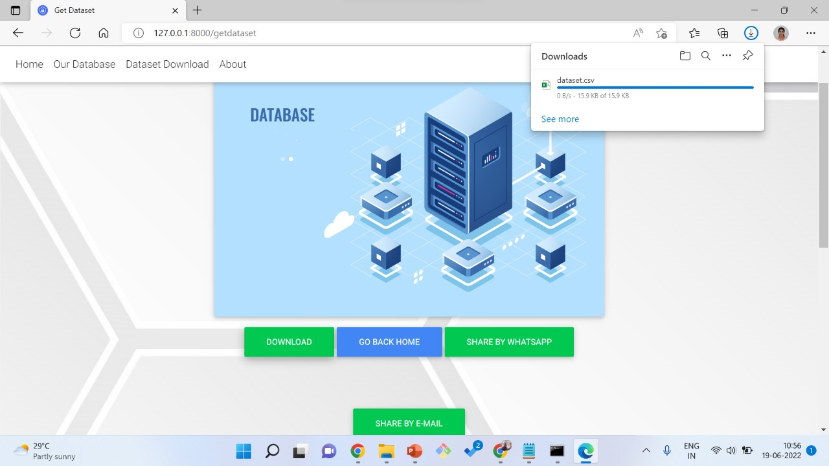
Screenshot 22

Slide 39
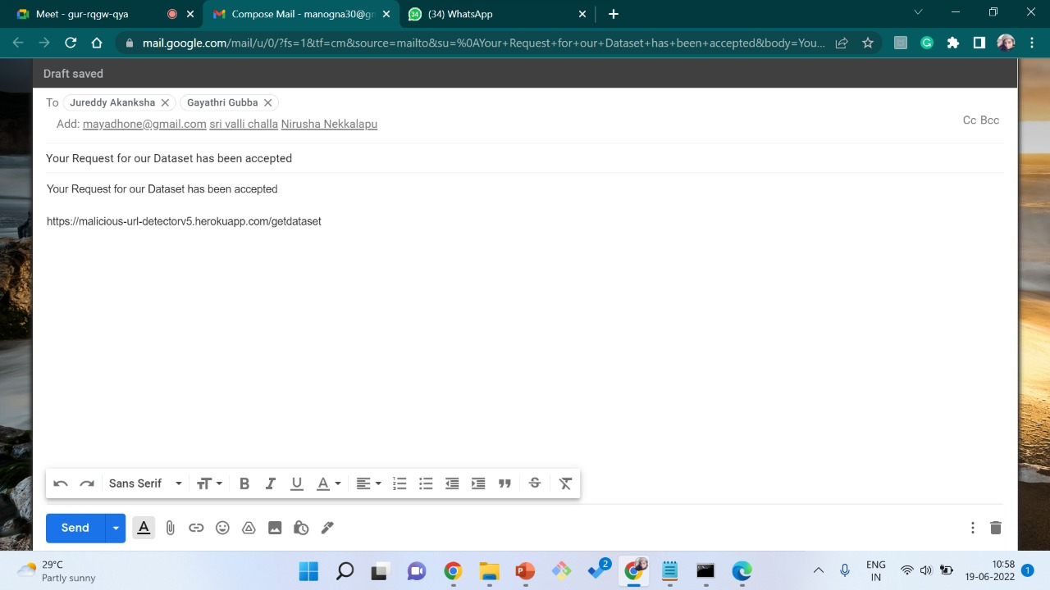
Screenshot 23:

Slide 40
Test Cases:
S. No | Test Case | Input | Expected Output | Actual Output | Result
1 | Real Time Analysis | URL start with https | Short window displaying that url is safe or Phishing detected | Short window displaying that url is safe or Phishing detected | Pass
2 | Real Time Analysis | URL not start with https | Displays 404 Error message | Displays 404 Error message | Pass

Slide 41
Validations:
S. No | Field Name | Validation | Message
1 | URL | Enter the URL starting with either http or https followed by :// and must contain www. And then followed by subdomain of length(2,256) & last part containing top level domain like .com, .org etc | Please fill out the field

Slide 42
CONCLUSION
We propose an end-to-end deep learning model BAT-MC that is composed of BLSTM and attention mechanisms. BAT-MC can well solve the problem of intrusion detection and provide a new research method for intrusion detection. The obtained feature information is reasonable and accurate. We evaluate our proposed network with a real NSL-KDD dataset. The experimental results show that the performance of BAT-MC is better than the traditional methods.

Slide 43
FUTURE SCOPE
This project only checks whether the given url is malicious or not. It can be modified by adding a learn more option which redirecting it to the requested website when clicked on it to know information in it. Another window gives warning with two option “Proceed to Continue” or “Back to Safety” when phishing detected.

Slide 44
REFERENCES
[1] B. B. Zarpelo, R. S Miani, C. T. Kawakani, and S. C. de Alvarenga, ‘‘A survey of intrusion detection in Internet of Things,’’ J. Netw. Comput. Appl., vol. 84, pp. 25–37, Apr. 2017.
[2] B. Mukherjee, L. T. Heberlein, and K. N. Levitt, ‘‘Network intrusion detection,’’ IEEE Netw., vol. 8, no. 3, pp. 26–41, May 1994.
[3] S. Kishorwagh, V. K. Pachghare, and S. R. Kolhe, ‘‘Survey on intrusion detection system using machine learning techniques,’’ Int. J. Control Automat., vol. 78, no. 16, pp. 30–37, Sep. 2013.
[4] N. Sultana, N. Chilamkurti, W. Peng, and R. Alhadad, ‘‘Survey on SDN based network intrusion detection system using machine learning approaches,’’ Peer-to-Peer Netw. Appl., vol. 12, no. 2, pp. 493–501, Mar. 2019.
[5] M. Panda, A. Abraham, S. Das, and M. R. Patra, ‘‘Network intrusion detection system: A machine learning approach,’’ Intell. Decis. Technol., vol. 5, no. 4, pp. 347–356, 2011.
[6] W. Li, P. Yi, Y. Wu, L. Pan, and J. Li, ‘‘A new intrusion detection system based on KNN classification algorithm in wireless sensor network,’’ J. Electr. Comput. Eng., vol. 2014, pp. 1–8, Jun. 2014.

Slide 45


